Slide 1
project3_talentberg
To learn ORM (Object Relational Mapping), Table Relationships

Slide 2
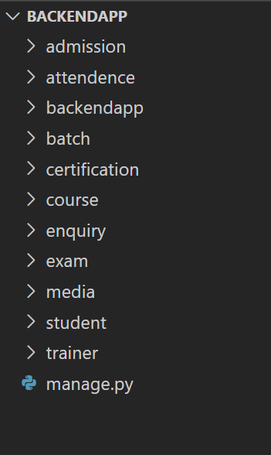
Step1 : Create following applications in Project

Slide 3
Step 2 : Model Classes

Slide 4
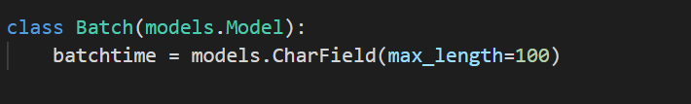
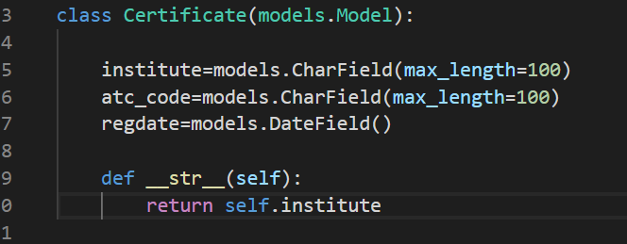
1
2

Slide 5
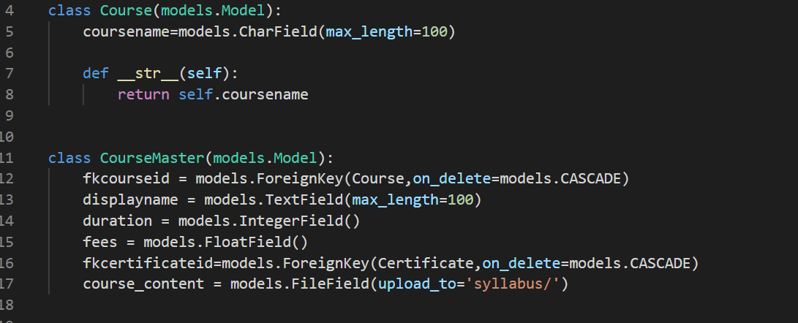
3

Slide 6
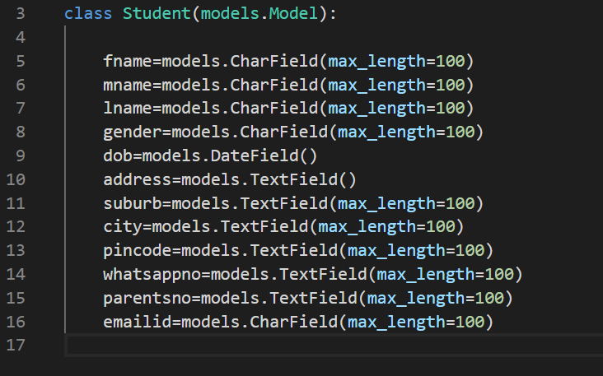
4

Slide 7
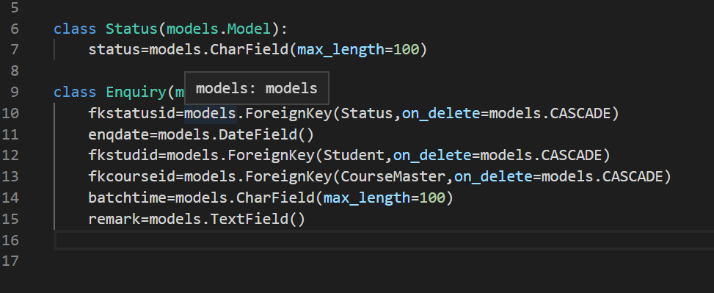
5

Slide 8
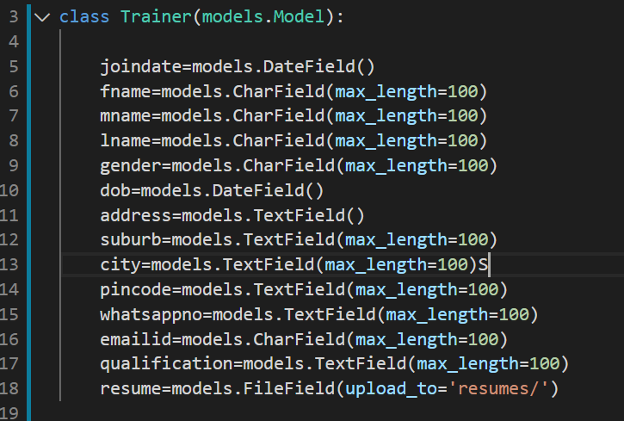
6

Slide 9
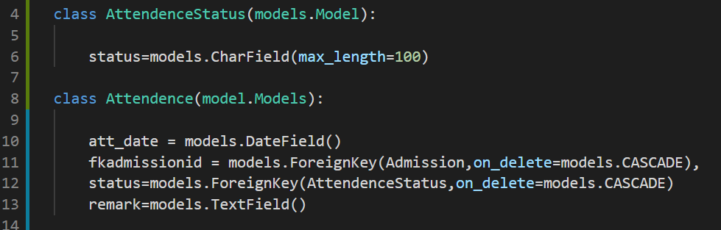
7

Slide 10
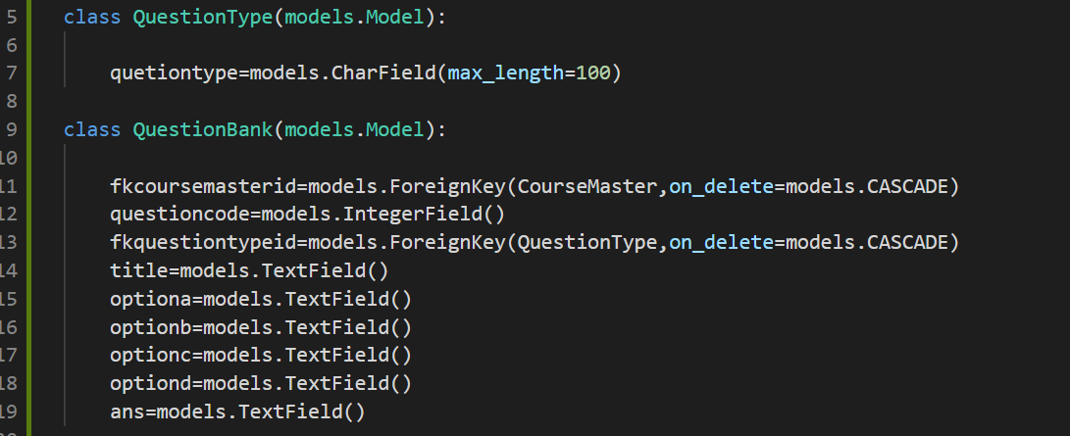
8

Slide 11
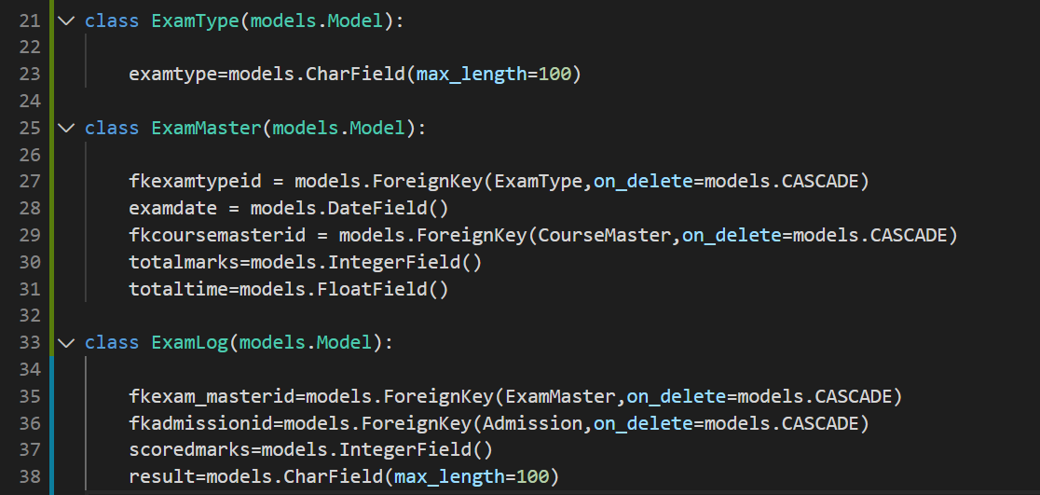
9

Slide 12
Step 3 : Create Forms

Slide 13
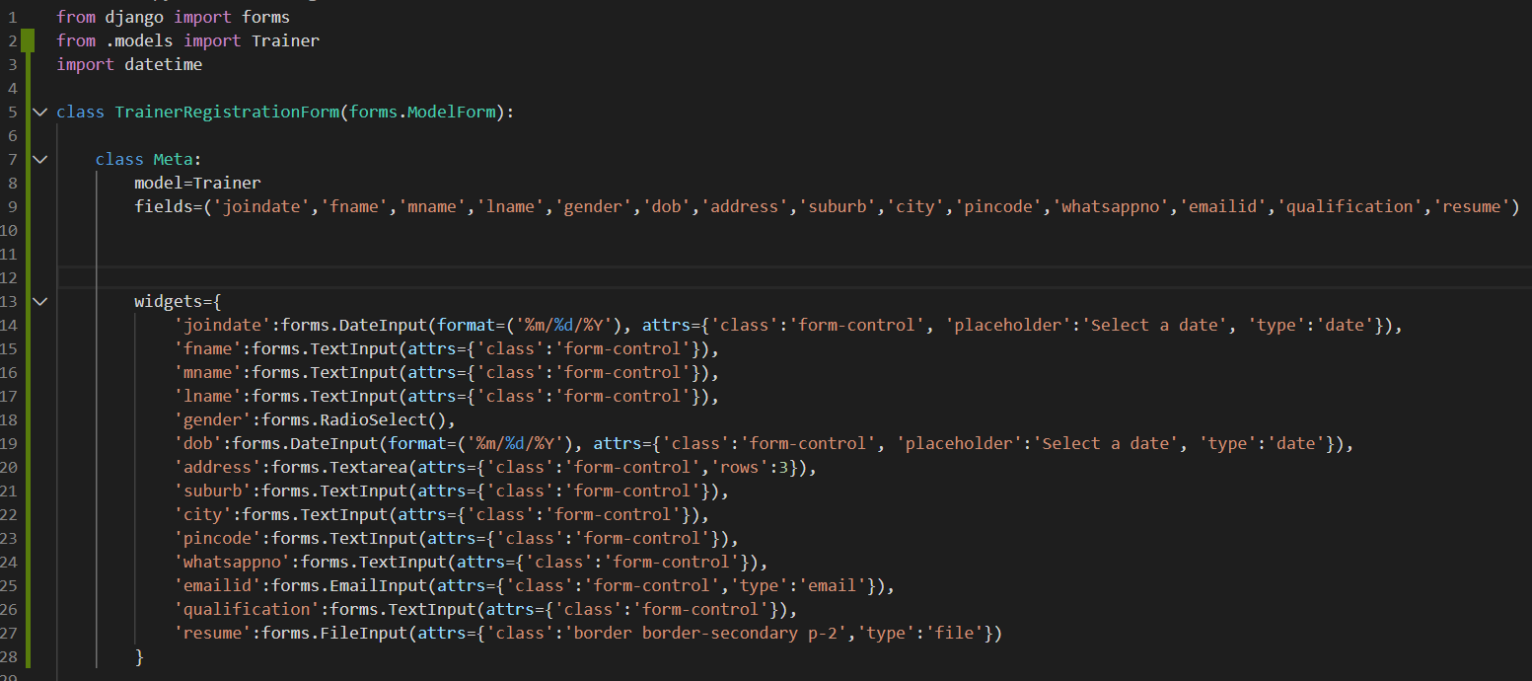
Create TrainerRegistrationForm in forms.py file

Slide 14
Step4 : Update Project Structure for Django Template Driven Forms

Slide 15
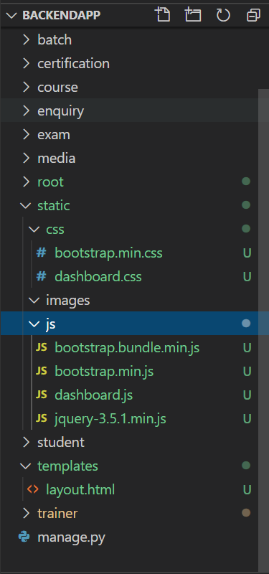
Create static and templates folder in project root where templates you use for master layout of your webside.

Slide 16
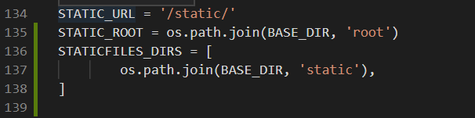
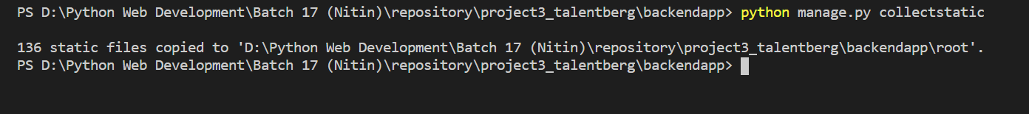
In settings.py add following code
Run python command python manage.py collectstatic

Slide 17
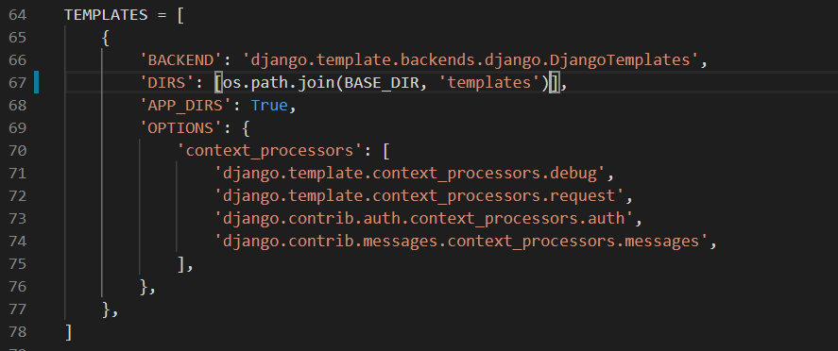
Change TEMPLATES settings in settings.py file

Slide 18
Step5 : Design layout.html as master form and trainer-create.html as child form

Slide 19
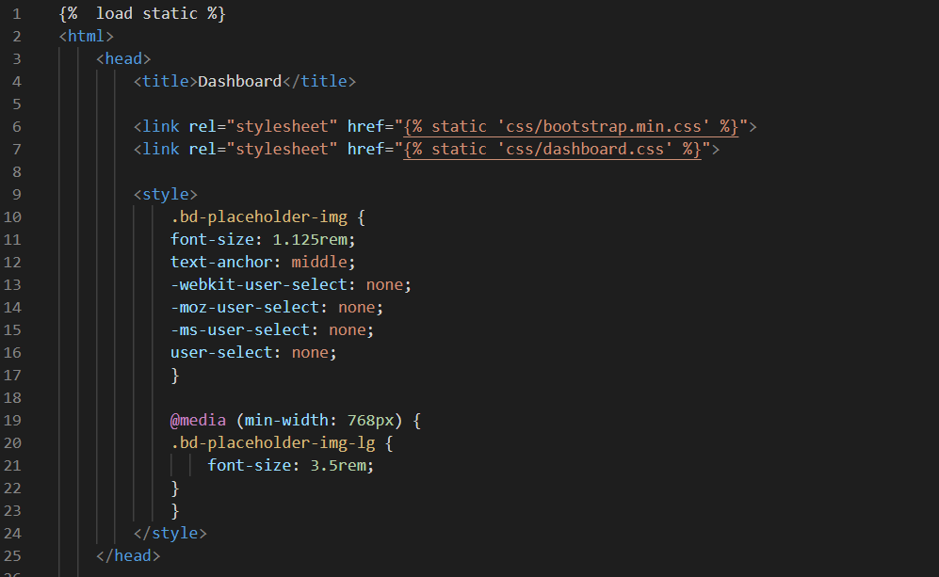
Link : layout.html code
https://github.com/shrenik77130/Repo3Batch17PythonFS/blob/master/project3_talentberg/backendapp/templates/layout.html

Slide 20
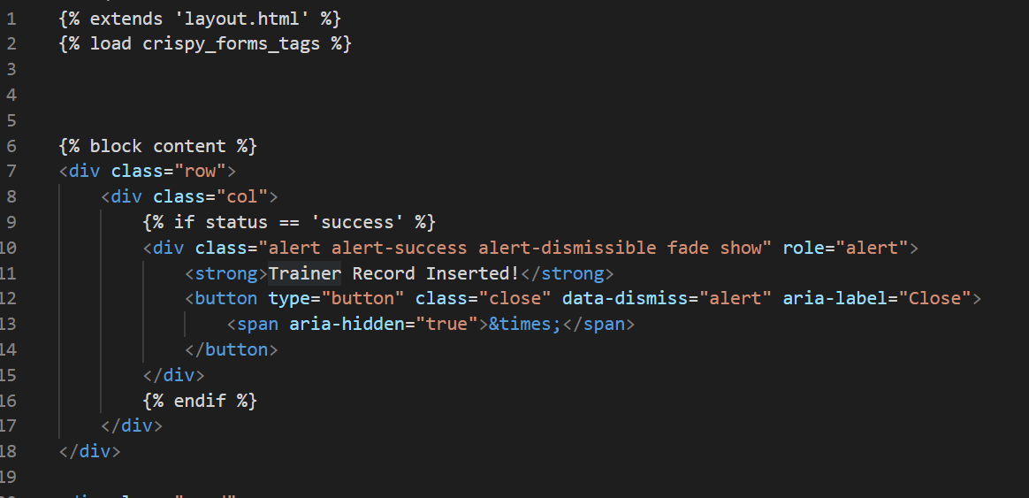
Link: create-trainer.html Code
https://github.com/shrenik77130/Repo3Batch17PythonFS/blob/master/project3_talentberg/backendapp/trainer/templates/trainer/trainer_create.html

Slide 21
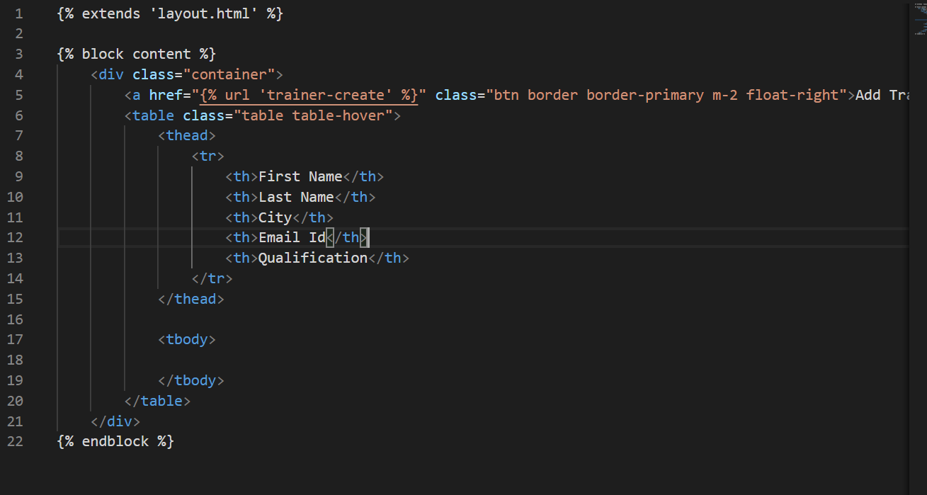
Link: trainer-table.html Code
https://github.com/shrenik77130/Repo3Batch17PythonFS/blob/master/project3_talentberg/backendapp/trainer/templates/trainer/trainer_create.html

